Slide 1
Enhancing Privacy in Social Network Data Analysis Using Cryptography and Differential Privacy
A Comprehensive Approach to Data Protection
Srushti Waichal (A20554818)
Om Gandhi (A20560944)

Slide 2
Objective: To enhance privacy in social network data analysis using cryptographic techniques and differential privacy.
Importance: With increasing data privacy concerns, it’s crucial to protect user data against various attacks while allowing meaningful analysis.

Slide 3
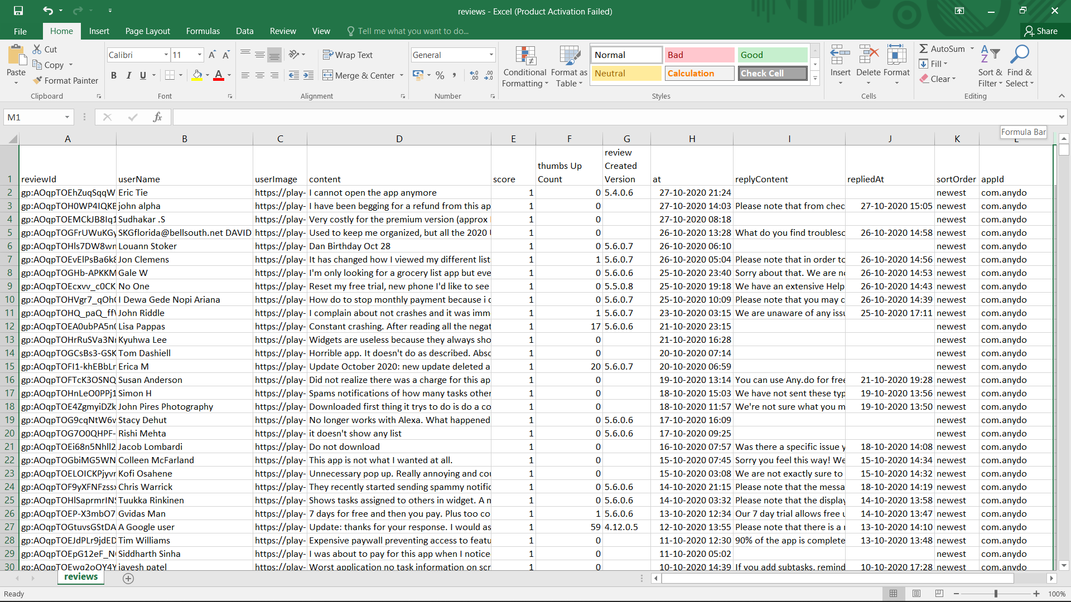
Dataset: User reviews with sensitive columns (reviewId, userName, userImage, etc.)

Slide 4
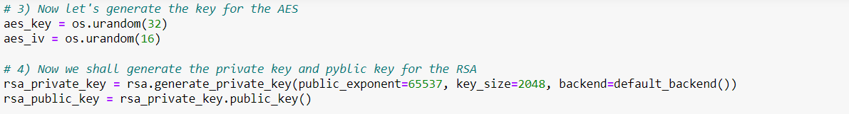
Key Generation
AES Key:
Purpose: Encryption of data.
Characteristics: 256-bit key for robust encryption, 128-bit IV for initialization vector to enhance security.
RSA Key:
Purpose: Encrypting the AES key.
Characteristics: 2048-bit RSA key pair for strong encryption, ensuring secure transfer of AES key.

Slide 5
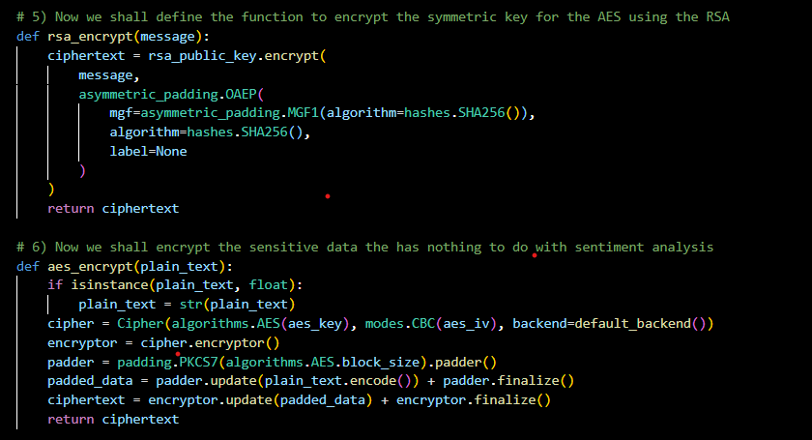
Encryption Implementation
AES implementation:
Here we used the original key to encrypt the data that was sensitive like username, userImage and so on.
RSA implementation:
We used the public key to encrypt the key of the AES and encrypted the key using that.

Slide 6
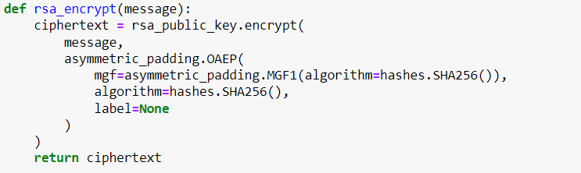
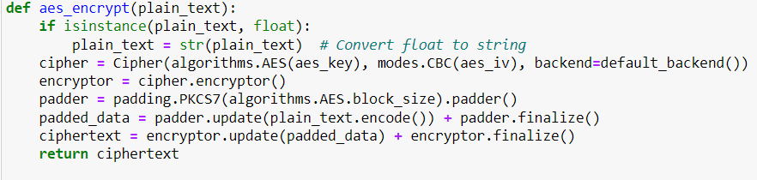
Encryption Functions
RSA Encryption:
Description: Utilizes RSA encryption to securely encrypt the AES key.
Functionality: Protects the AES key during transmission, enhancing data security.
AES Encryption:
Description: Employs AES encryption with PKCS7 padding for encrypting sensitive data.
Functionality: Ensures confidentiality and integrity of sensitive information through robust encryption techniques.

Slide 7
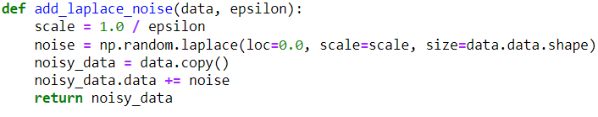
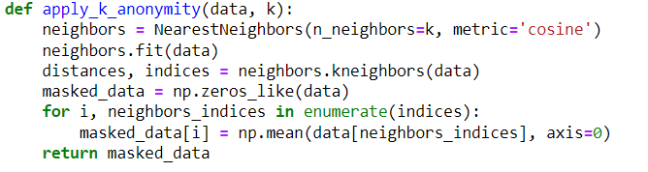
Differential Privacy and k-Anonymity
Laplace Noise:
Description: Adds random noise to data to achieve differential privacy.
Importance: Preserves individual privacy while allowing meaningful analysis of d
k-Anonymity:
Description: Averages data within clusters to obscure individual records.
Significance: Enhances privacy by making it difficult to identify specific individuals from the dataset.

Slide 8
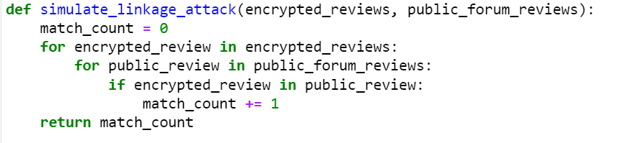
Linkage and Inference Attack Simulations
Linkage Attack:
Description: Attempts to match encrypted reviews with public forum reviews.
Result: Successful encryption prevents any matches, showcasing the effectiveness of the privacy measures.
Inference Attack
Description: Utilizes sentiment analysis and topic modeling on encrypted data to detect potential data leakage.
Result: Encrypted sentiments and topics remain general, indicating successful data obfuscation.

Slide 9
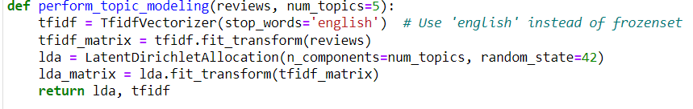
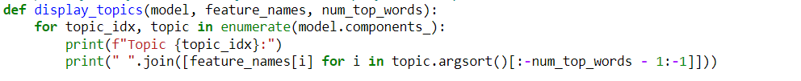
Sentiment Analysis and Topic Modeling
Sentiment Analysis:
Description: Employs VADER sentiment analysis on encrypted data.
Result: Encrypted sentiments display a range of emotions, demonstrating the feasibility of sentiment analysis while maintaining privacy.
Topic Modeling:
Description: Utilizes Latent Dirichlet Allocation (LDA) for identifying topics in encrypted data.
Result: Derived topics are generic, ensuring privacy of sensitive information.

Slide 10
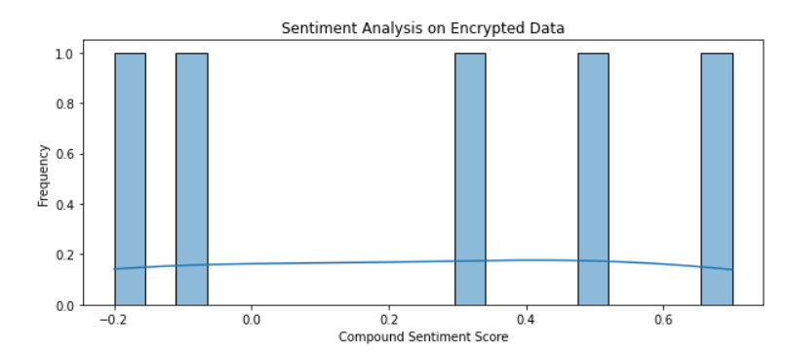

Slide 11
Model Training and Evaluation
TF-IDF Vectorization:
Description: Transforms text data into TF-IDF vectors for model training.
Random Forest Classifier:
Description: Trains model on transformed data for sentiment analysis and topic modeling.
Accuracy Evaluation:
Description: Compares accuracy with and without privacy enhancements, showcasing the impact of privacy measures on model performance.
Conclusion:
Privacy enhancements lead to reduced accuracy, highlighting the trade-off between privacy and utility.

Slide 12
Accuracy Results
With Encryption:
Accuracy: 43.66%
With Encryption and Differential Privacy:
Accuracy: 39.94%
With Encryption, Differential Privacy and k-Anonymity:
Accuracy: 21.61%

Slide 13
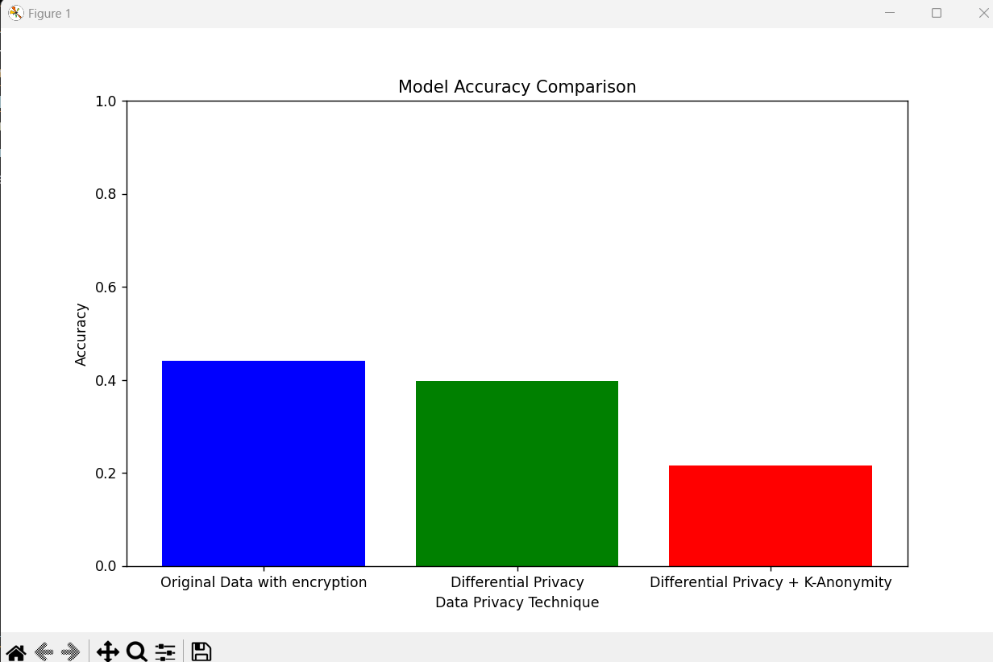

Slide 14
Results
As seen in the graph the accuracy of the model drops drastically when differential privacy is introduced.
And upon that, when k-anonymity was introduced the accuracy dropped even more.
However, this also reduced the chance of inference attack and the linkage attack as well.
The reason for accuracy drop was because the noisy data was added in order to ensure the privacy of the users and lessen the chances of the linkage attack.
Upon that we also introduced k-anonymity as well to ensure some more privacy to the data but because the real data was manipulated or some noise was added, it was obvious that the accuracy would drop.
Hence, it clear that with increase in privacy the accuracy decreases so they are inversely proportional to each other.
Apart from this we also know that if the key for the cryptographic algorithm is known or easy to crack then we can’t protect the sensitive data much.
However, because we encrypted the key used for AES as well that would decrease the chances of data leaks in the sensitive data.

Slide 15
Trade-offs Between Privacy and Utility
Accuracy vs. Privacy:
Balance between privacy measures and data utility.
Inversely proportional to each other.
Differential Privacy Impact:
Slight accuracy reduction due to noise addition for privacy.
k-Anonymity Impact:
Significant accuracy reduction with combined privacy techniques, highlighting the impact on data analysis.

Slide 16
Future Work
Optimize Privacy Parameters:
Balance between privacy, accuracy, and performance.
Advanced Encryption Techniques:
Explore homomorphic encryption for enhanced security.
Scalability and Performance:
Evaluate efficiency on larger datasets for scalability.
User Perception and Trust:
Assess impact on user trust and perception with enhanced privacy measures.

Slide 17
Conclusion
Hence, upon analysis it was pretty clear as discussed above that here data privacy and accuracy of the model are inversely proportional.
But it can also be inferred that because the privacy was introduced the chances of inference attack or linkage attack decreased.
Upon that we also observed during encryption it could have been really easy to break the Advanced encryption cipher on the sensitive data.
However, because we encrypted the key as well using the asymmetric key cryptography algorithm (the RSA), the chances of cipher decryption would also decrease in this case.

